Slide 1

COSMO CODE
by
Sanket Pundhir (202410116100183)
Ridhi Rajput (202410116100165)
Session:2025-2026 (IV Semester)
Under the supervision of
Dr. Vipin Kumar (Associate Professor)
Mr. Shish Pal Jatav (Assistant Professor)
Department Of Computer Applications
KIET GROUP OF INSTITUTIONS, DELHI-NCR, GHAZIABAD-201206

Slide 2
What is Cosmo Code?
AI-Powered Analysis
Multi-Language Support
Enhanced Learning
An AI-powered coding analyzer designed to debug, optimize, and explain code.
Supports multiple programming languages through a single intelligent interface.
Enhances learning by explaining logic errors and suggesting improvements.
Seamless Experience
Broad Audience
Uses Monaco editor for a smooth, developer-like coding experience.
Built for students, professionals, and educators alike.

Slide 3



Three AI Models – Their Strengths
Gemini
OpenAI GPT
Claude
Exceptional for structured reasoning and logical clarity in code analysis.
Strong capabilities in code rewriting, creative solutions, and optimization suggestions.
Offers highly consistent, reliable, safe, and precise code corrections and explanations.
The combined strengths of these models cover comprehensive explanation, robust logic, superior readability, and optimal performance. Parallel querying ensures a diverse array of potential solutions.

Slide 4
Cosmo Code Features
Multi-language support: Seamlessly debug and optimize code in Python, C++, Java, and JavaScript.
One-click 'Apply Fix': Implement suggested corrections with a single click.
Side-by-side AI comparison: View and compare solutions from multiple leading AI models.
Real-time error detection: Instant feedback with beginner-friendly explanations.
Future potential: Opportunities for voice input integration and advanced ML analytics.
Automatic optimization: Includes in-depth complexity analysis for improved performance.
Clean UI with Monaco editor: Enjoy a familiar and efficient coding environment.

Slide 5
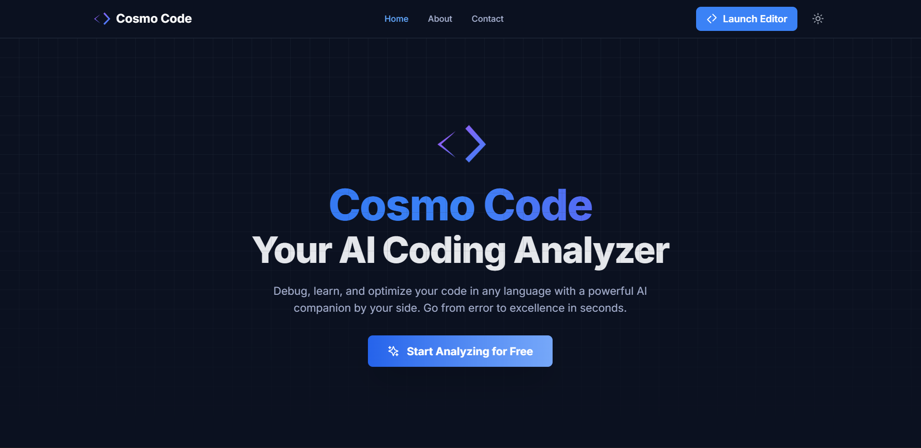
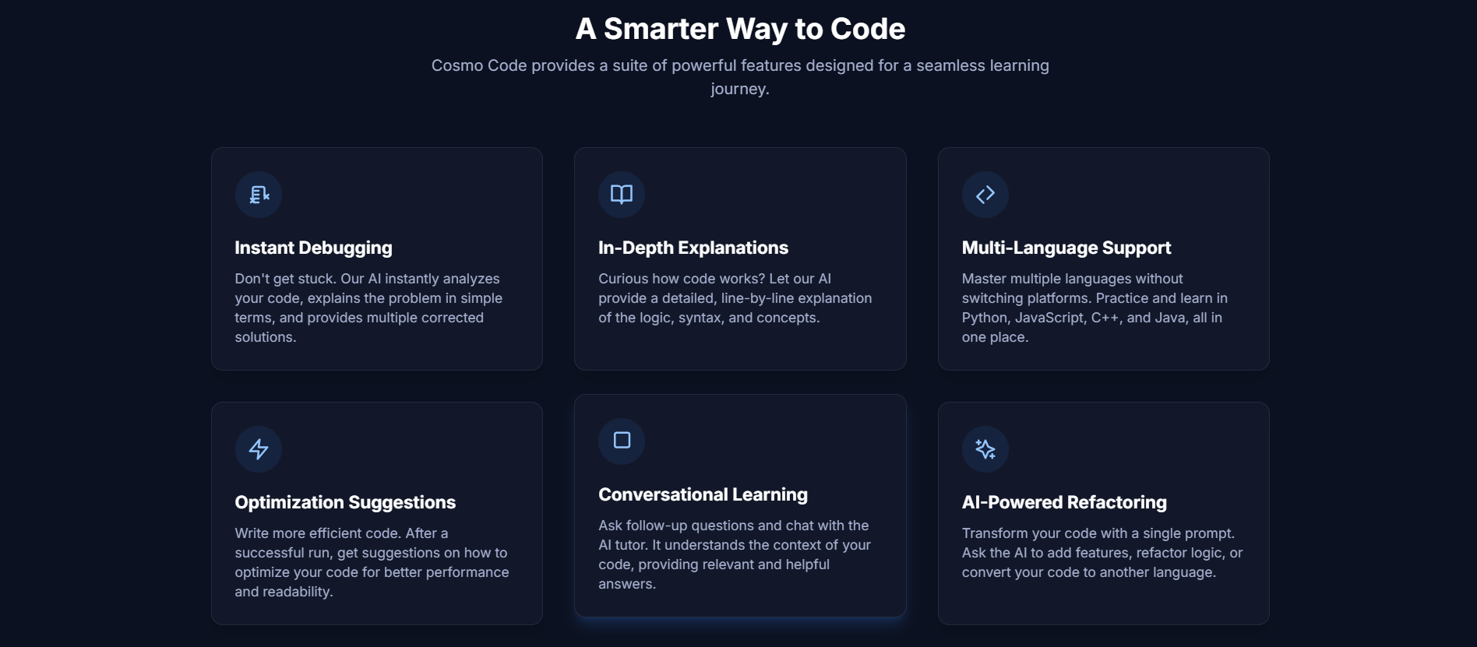
Home Page

Slide 6
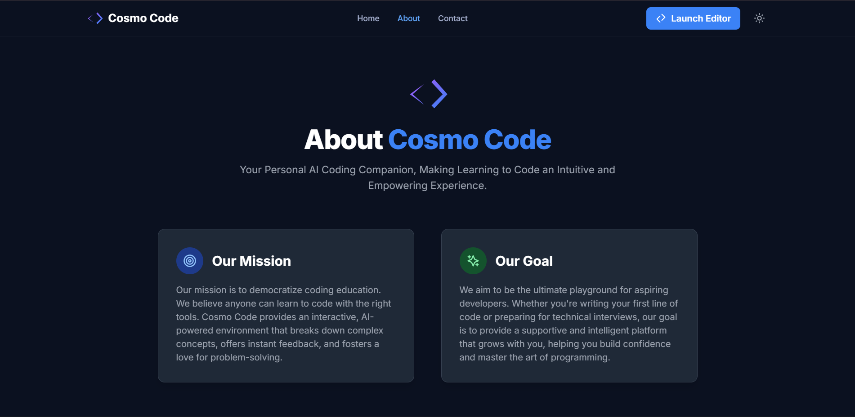
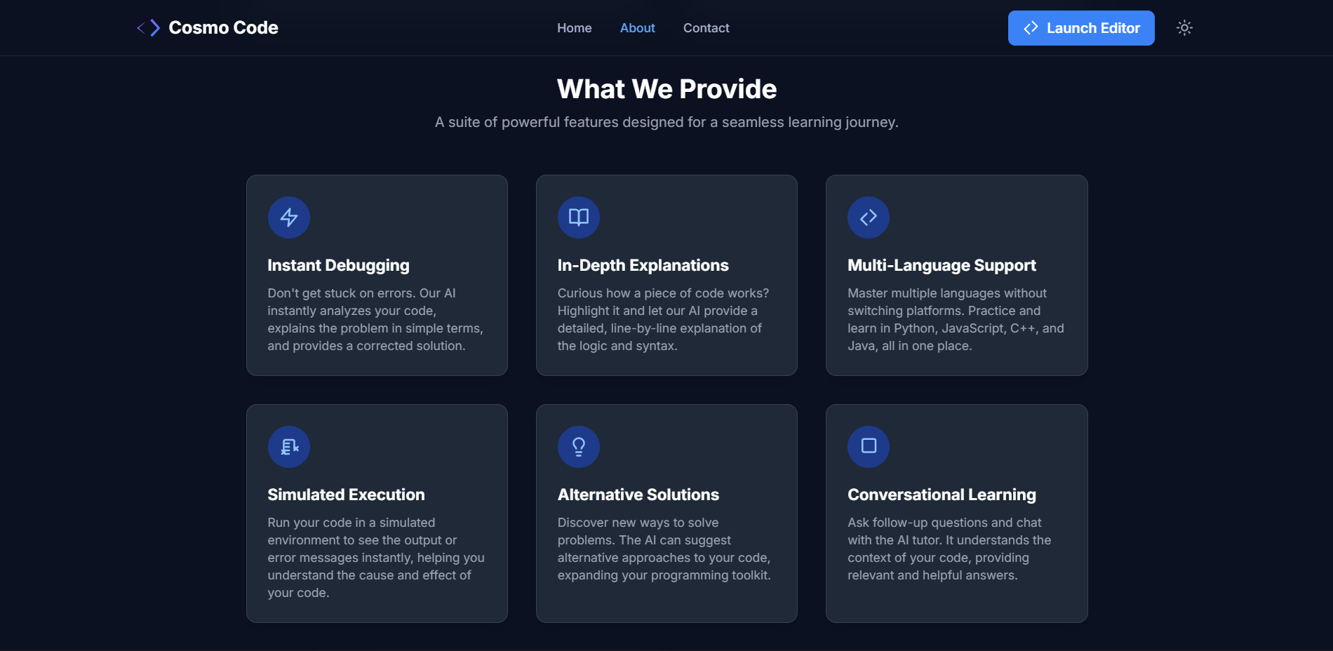
About Page

Slide 7
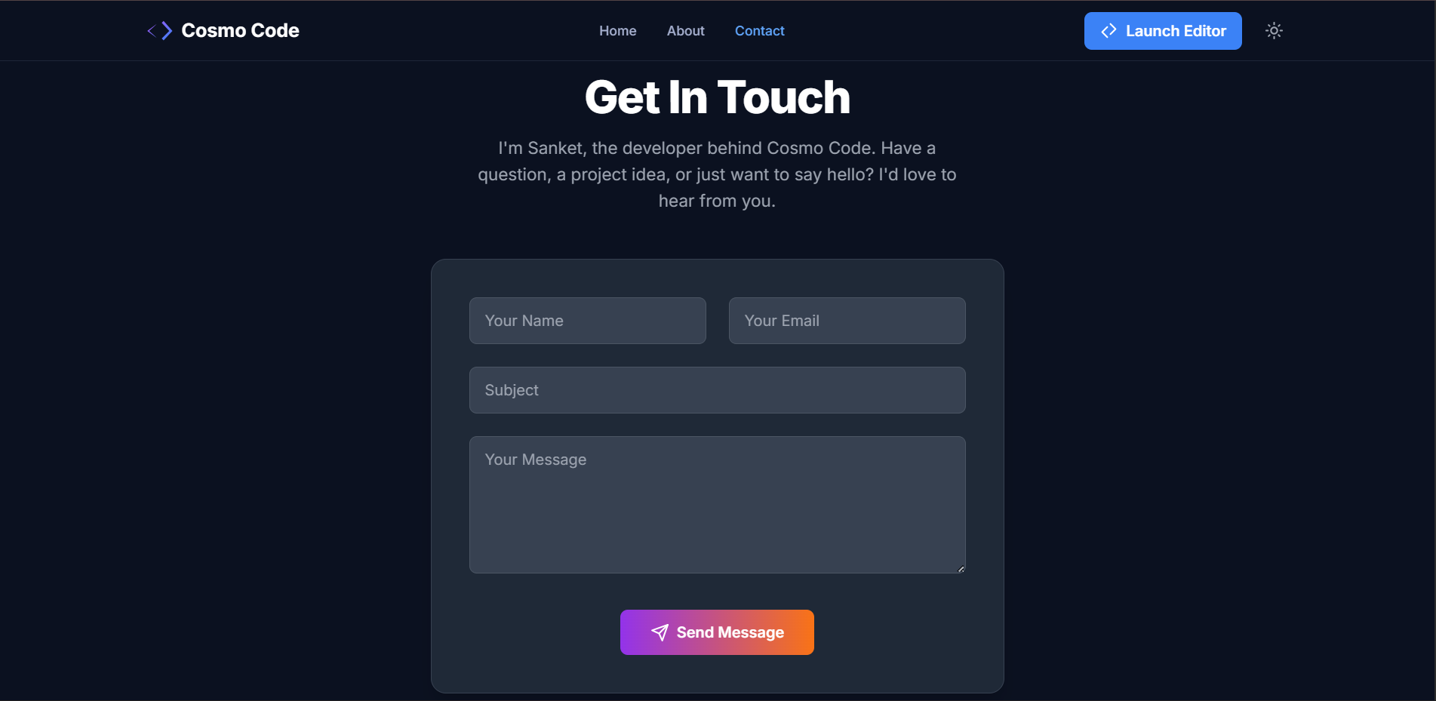
Contact Page

Slide 8
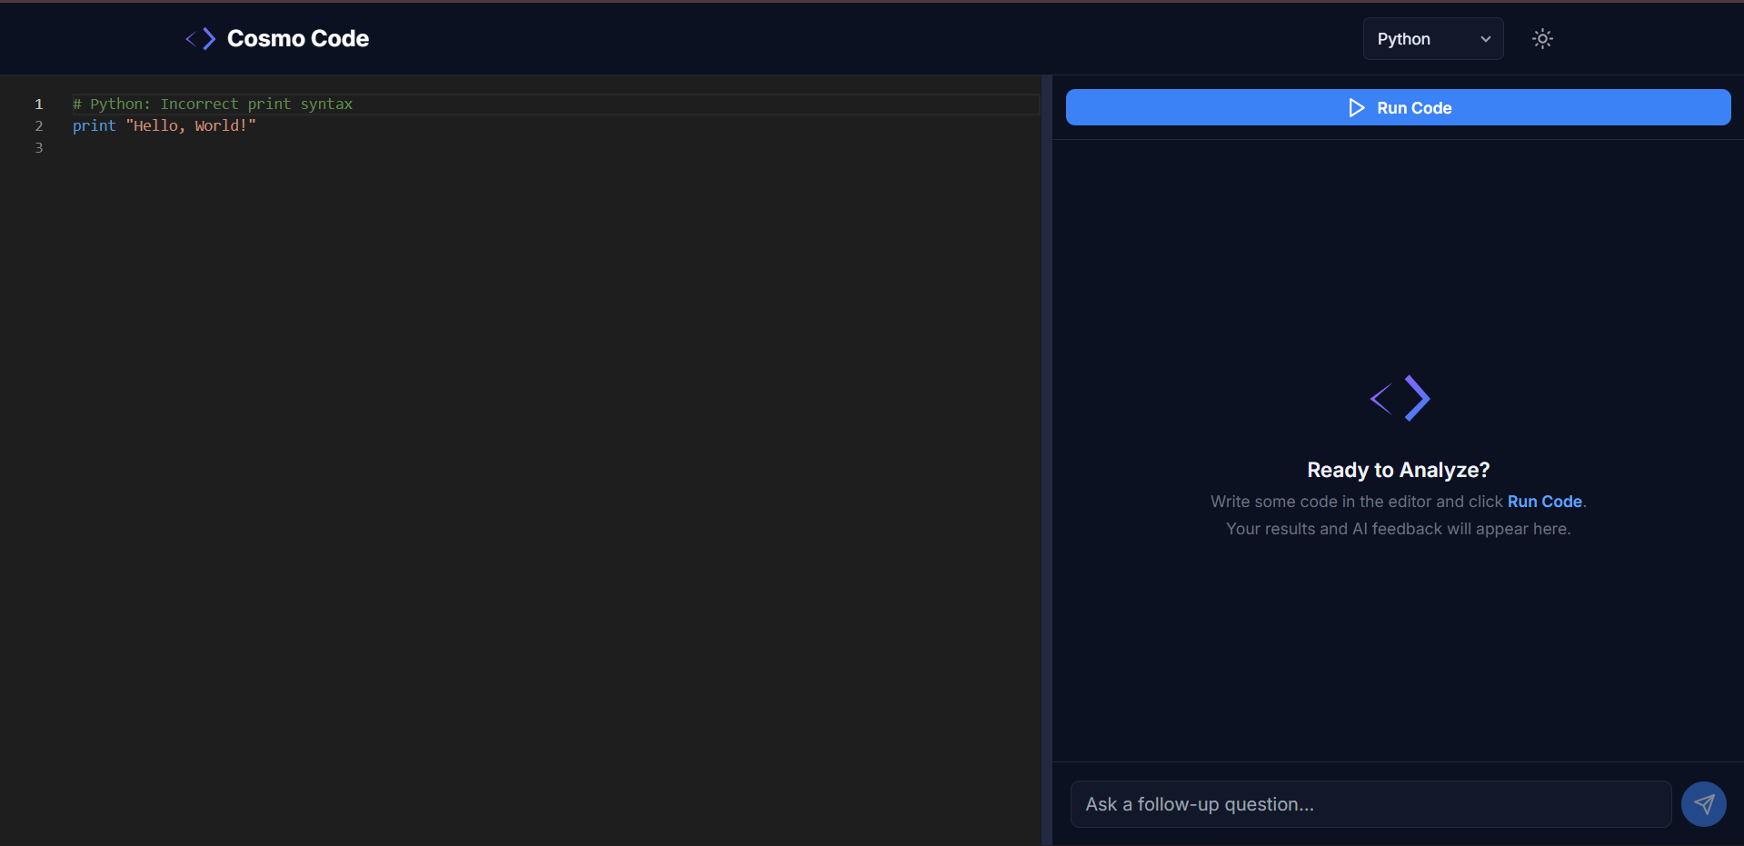
Monaco Editor

Slide 9
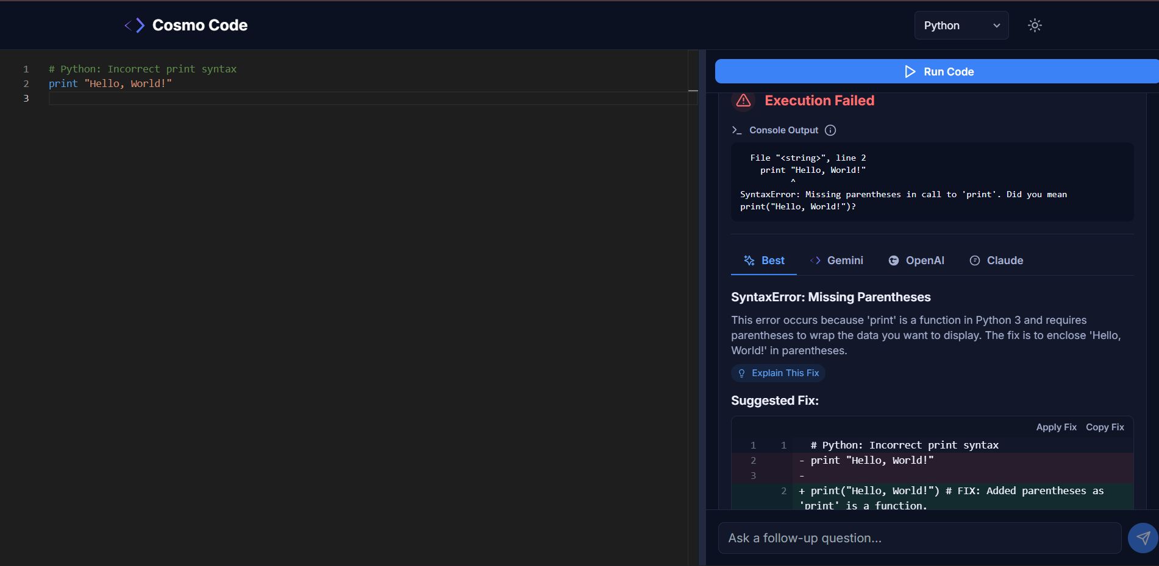
Error Detection

Slide 10
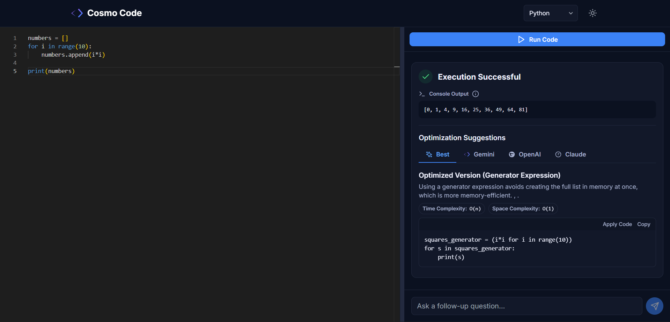
Optimization

Slide 11
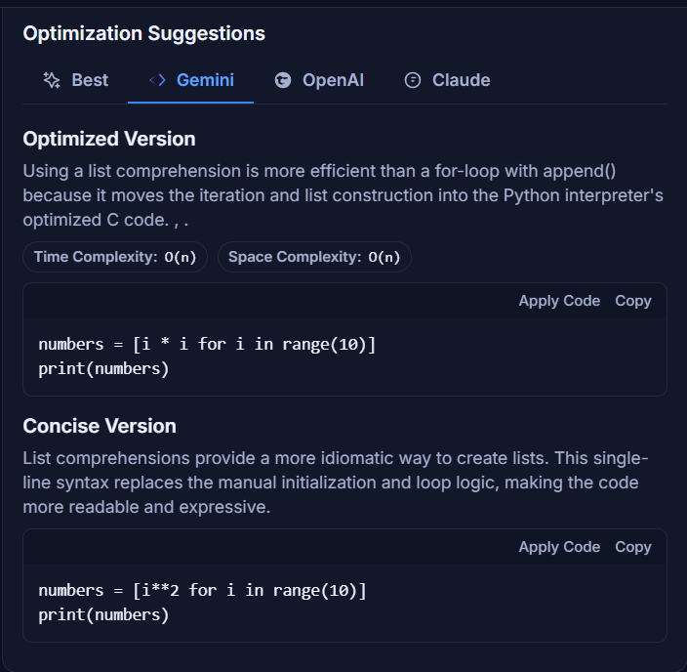
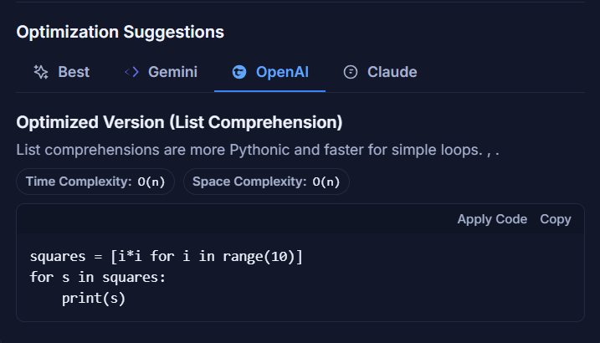
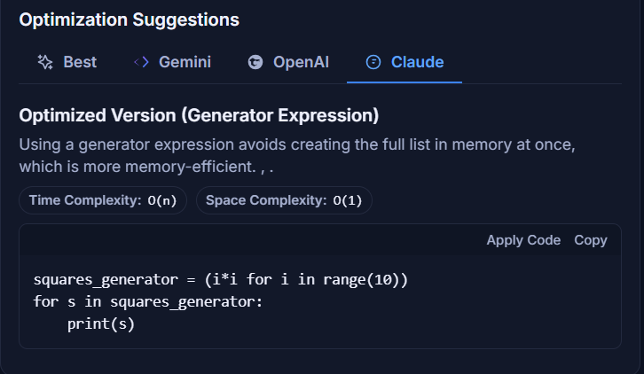
Multiple AI model

Slide 12

THANK YOU !

